Slide 1
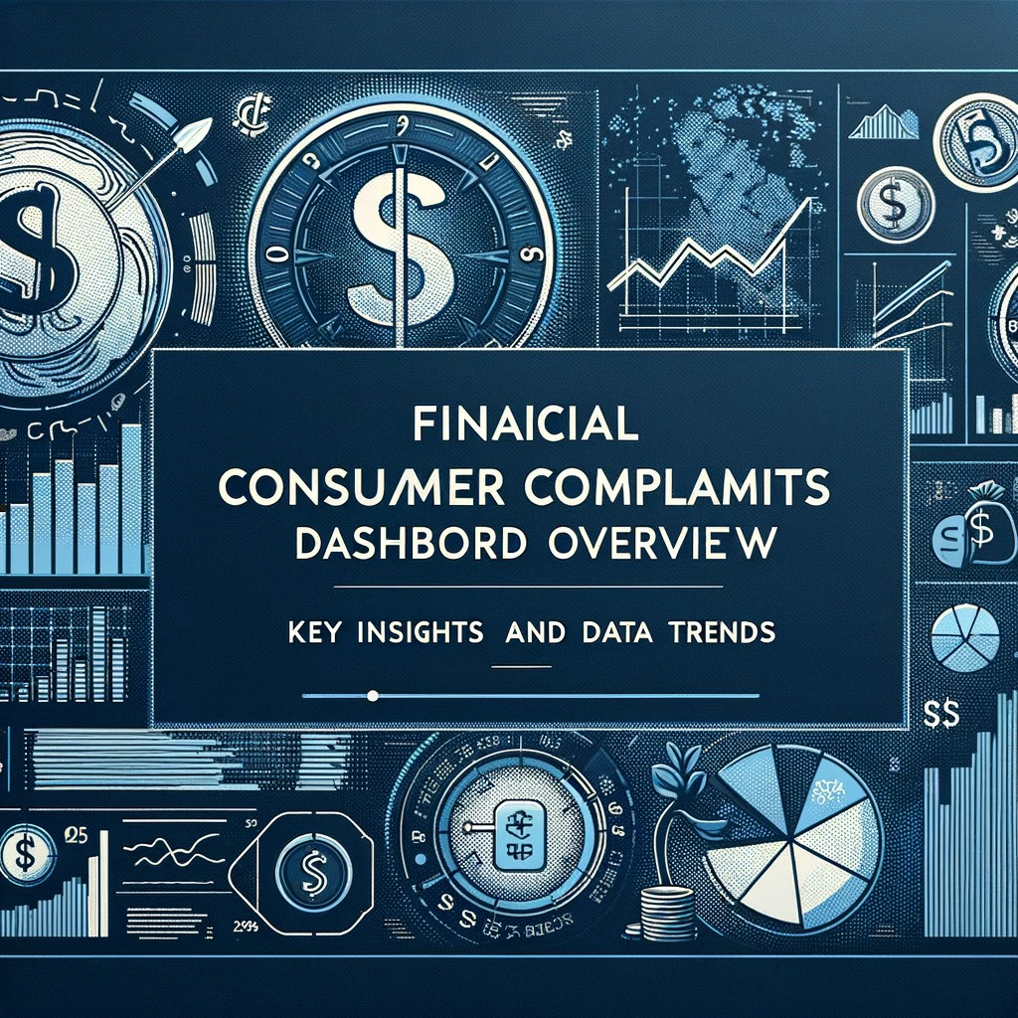
Financial Consumer Project
Data Analysis project
Tools of Analysis: python & Power BI

Slide 2
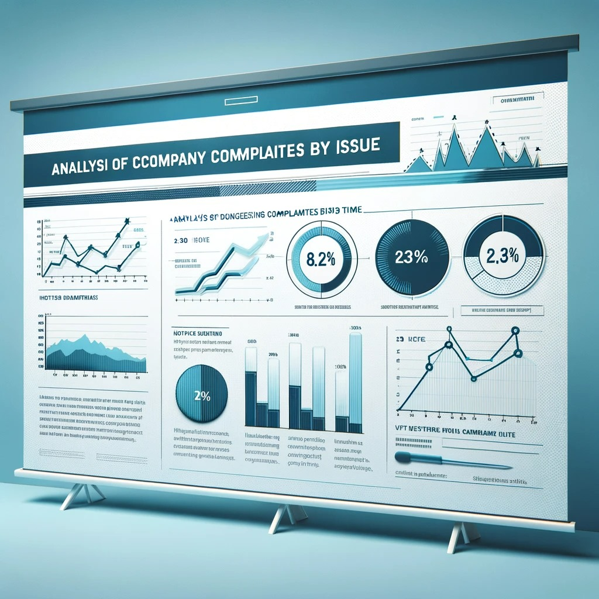
Executive Summary
  This comprehensive dashboard provides a multi-faceted view of financial consumer complaints, highlighting significant trends and distributions across various dimensions using POWER BI.

Slide 3
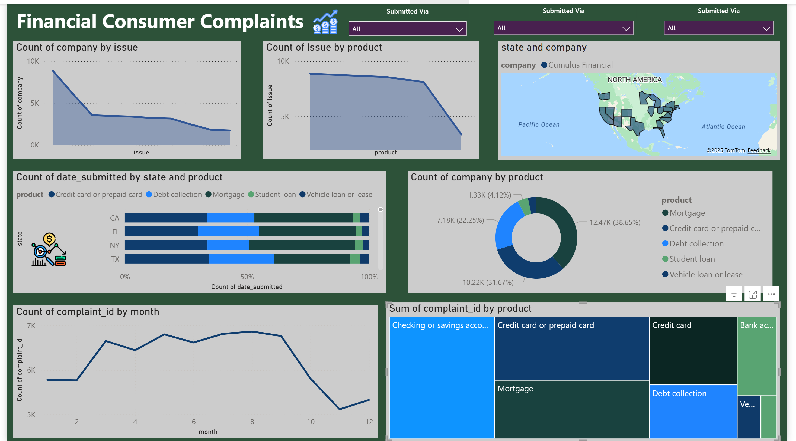
Dashboard Overview

Slide 4
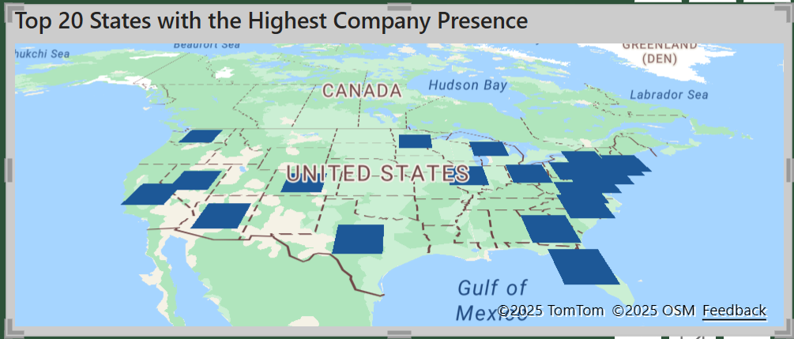
Data interpretation and insights
Analysis of Company Presence in US States
What regions show the highest company presence? The East Coast of the United States, particularly states like New York and Florida, demonstrate a higher concentration of company presence.
What implications does this distribution have? These clusters may reflect strategic locations for finance-related businesses, suggesting a potential need for localized consumer financial services and regulatory attention.
How should companies use this information? Businesses can utilize this data for market penetration strategies and to ensure adequate resource allocation in areas with significant presence to manage consumer relations effectively.

Slide 5
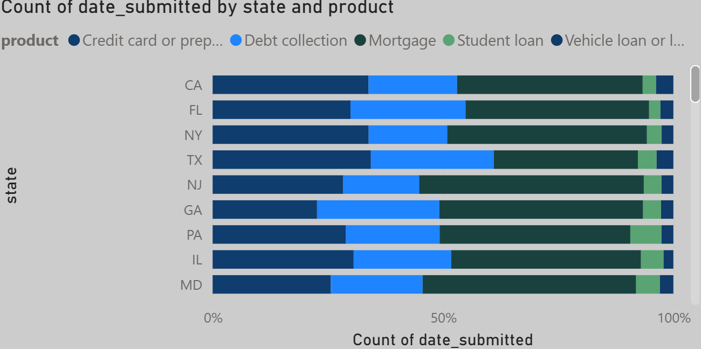
Data interpretation and insights
State-Specific Product Complaint Analysis
What is the trend throughout the year? Fluctuations are present with a peak around mid-year, followed by a sharp decline towards the year's end.
What could this pattern indicate? Potential seasonal impacts on complaint volumes or the effectiveness of mid-year initiatives.
What measures should be considered? Analyze the reasons for the mid-year peak and late-year drop to inform continuous improvement efforts and prepare for potential seasonal trends.

Slide 6
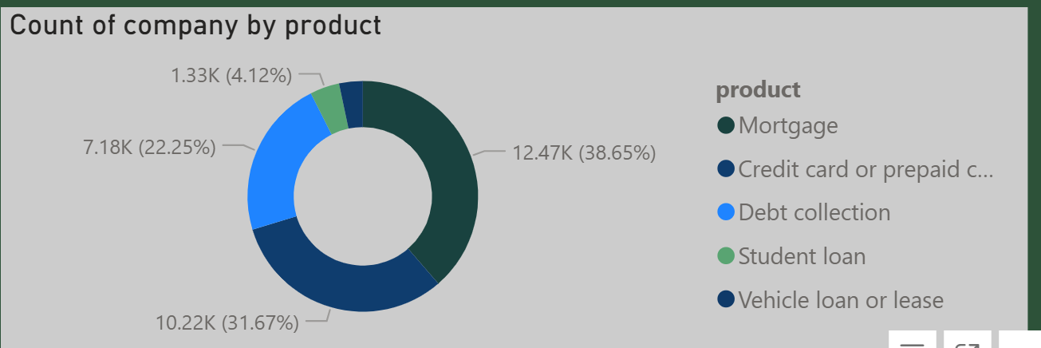
Data interpretation and insights
State-Specific Product Complaint Analysis
What is the trend throughout the year? Fluctuations are present with a peak around mid-year, followed by a sharp decline towards the year's end.
What could this pattern indicate? Potential seasonal impacts on complaint volumes or the effectiveness of mid-year initiatives.
What measures should be considered? Analyze the reasons for the mid-year peak and late-year drop to inform continuous improvement efforts and prepare for potential seasonal trends.

Slide 7
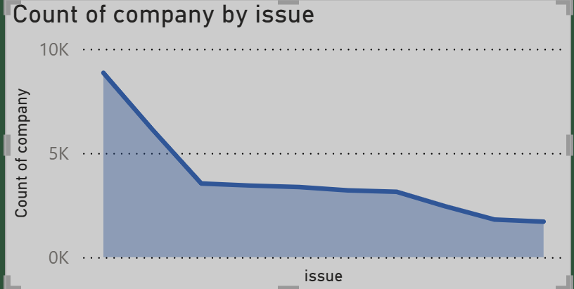
Data interpretation and insights
What Insights Can We Gain on Product-Related Issues?
What is the trend? A steady decrease in issue counts across products.
What does this suggest? Possible improvements in product quality or customer service.
What actions are advised? Continue enhancing product features and addressing customer needs to maintain this positive trend.

Slide 8
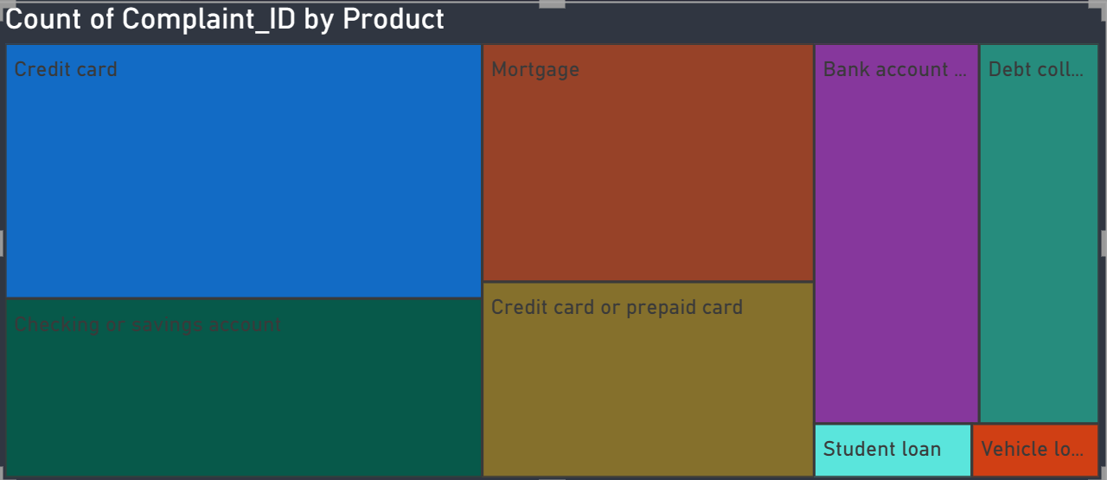
Data interpretation and insights
Complaint Volume by Financial Product
Which financial products receive the most complaints? Credit cards, followed by mortgages, represent the largest segments of complaints.
What can we infer from this data? These are likely areas where consumers face the most challenges, indicating potential for product and service improvements.
Recommended Focus: Prioritize enhancements in credit card and mortgage services to address common consumer issues and improve overall satisfaction.

Slide 9
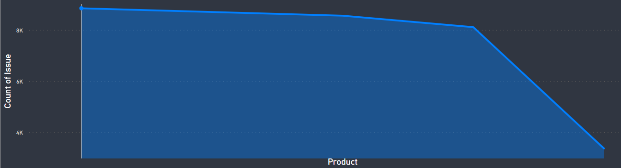
Data interpretation and insights
What Does the Complaint Trend Reveal?
What is the trend? A pronounced downward trend followed by stabilization.
What does this imply? Effective resolution of issues or improved services.
What should we do next? Continuously monitor for any increases in complaints to guide improvements.

Slide 10
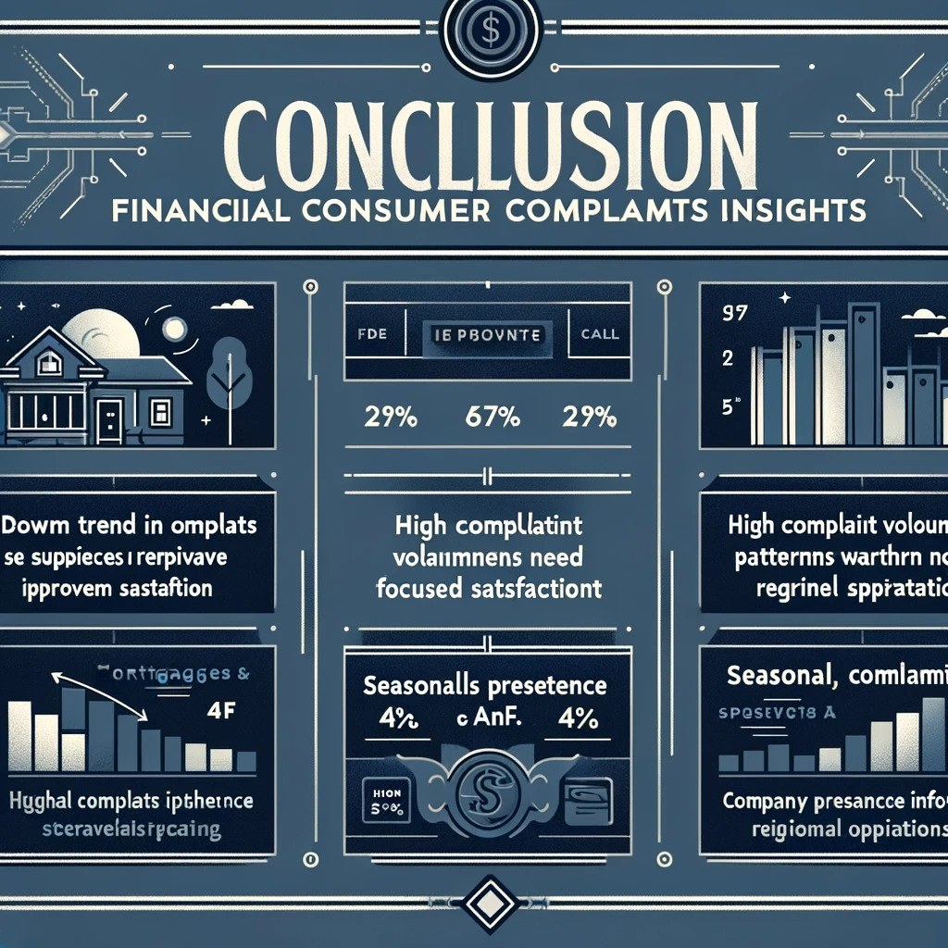
Synthesizing Financial Consumer Complaint Data Conclusion
Concluding Remarks:
Our comprehensive analysis of the Financial Consumer Complaints Dashboard reveals valuable insights into consumer behavior and company performance across various financial products and regions. Key takeaways include:
Trend of Complaints: We observe a general downward trend in the number of complaints over time, indicating potentially improved customer satisfaction and effective resolution strategies.
Product-Specific Complaints: Mortgages and credit cards are the predominant sources of complaints, signaling a need for focused improvement in these areas.

Slide 11
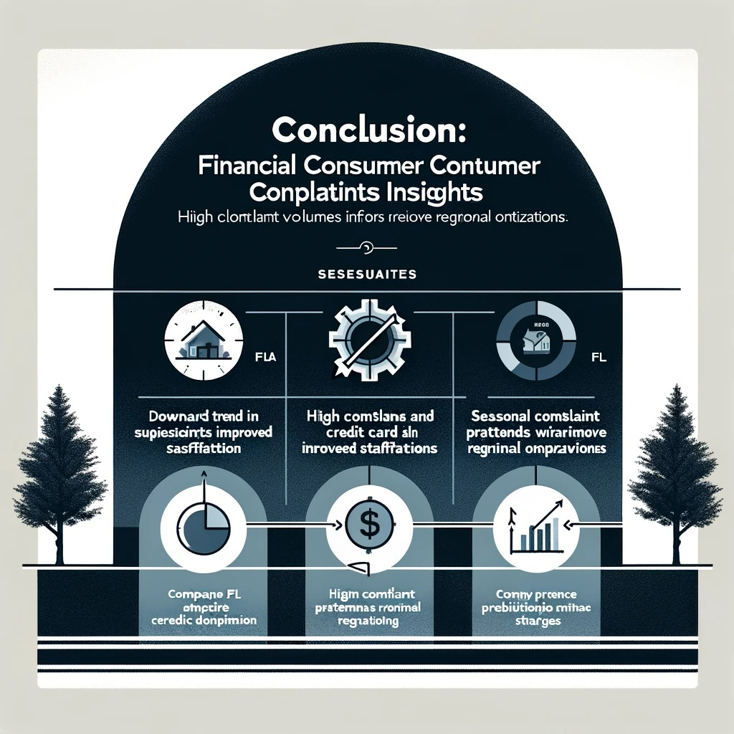
Synthesizing Financial Consumer Complaint Data Conclusion
State-Specific Trends: Certain states, like California and Florida, exhibit higher volumes of complaints, which may align with their larger populations and active financial sectors.
Temporal Fluctuations: Complaints show seasonal patterns, with peaks and troughs indicating potential areas for targeted customer support during specific times of the year.
Company Presence:
A concentration of company presence in specific states correlates with the number of complaints, suggesting that operational scale may impact consumer experience

Slide 12


